Slide 1
Predicting Delinquent Loans w/ Freddie Mac

Slide 2
Objective
01
Data
02
Table of contents
Iterative Modeling
03
Final Results
04

Slide 3
Objective:
Predict if a 15-year term mortgage will ever be 90 days late or more.
Determine if that model can be extended into the future.
Two main test sets are used:
Normal test set
Out-of-time test set

Slide 4
Data: Key Facts
6M
Loans
33 Feats.
9%
Positive Class (90-days late)

Slide 5
Data: Key Features
Credit Score
Original DTI Ratio
Original Interest Rate
Original UPB
Original LTV
Unit Count
Summarizes
the borrower’s creditworthiness,
Borrower’s monthly debts / monthly income
Original unpaid principal balance
Mortgage amount /
Min(appraised value, purchase price)

Slide 6
Iterative Modeling
Sampling
Baseline
Preprocess/Feature Engineer
No Preprocessing

Slide 7
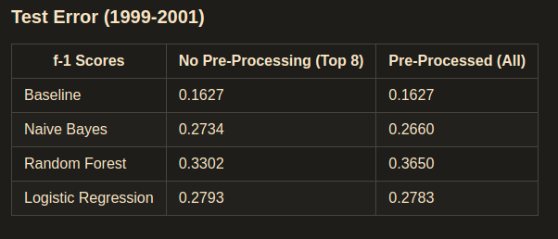
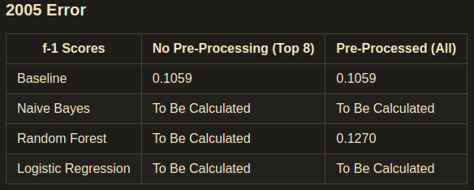
Results

